Slide 1
Deriving Clinical Coagulation Test Relationships From Clinical Laboratory Data

Slide 2
Outline
Background - Short primer on coagulation pathway and the coagulation tests that are used clinically
Project
Goals – Use clinical laboratory data to substantiate clinical assumptions about the patterns in these tests
Data used – Origin and biases in the data
Results
Conclusions and future directions

Slide 3
Outline
Background - Short primer on coagulation pathway and the coagulation tests that are used clinically
Project
Goals – Use clinical laboratory data to substantiate clinical assumptions about the patterns in these tests
Data used – Origin and biases in the data
Results
Conclusions and future directions

Slide 4
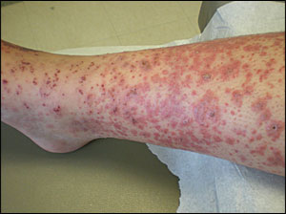
Coagulation testing
Ordered when suspected bleeding disorder
Testing begins with two screening tests:
Prothrombin time (PT)
Partial thromboplastin time (PTT)
Screening tests are meant to screen for deficiencies in one of the nine coagulation factors
Screening tests are followed up with testing for factors as indicated by the screening tests.

Slide 5
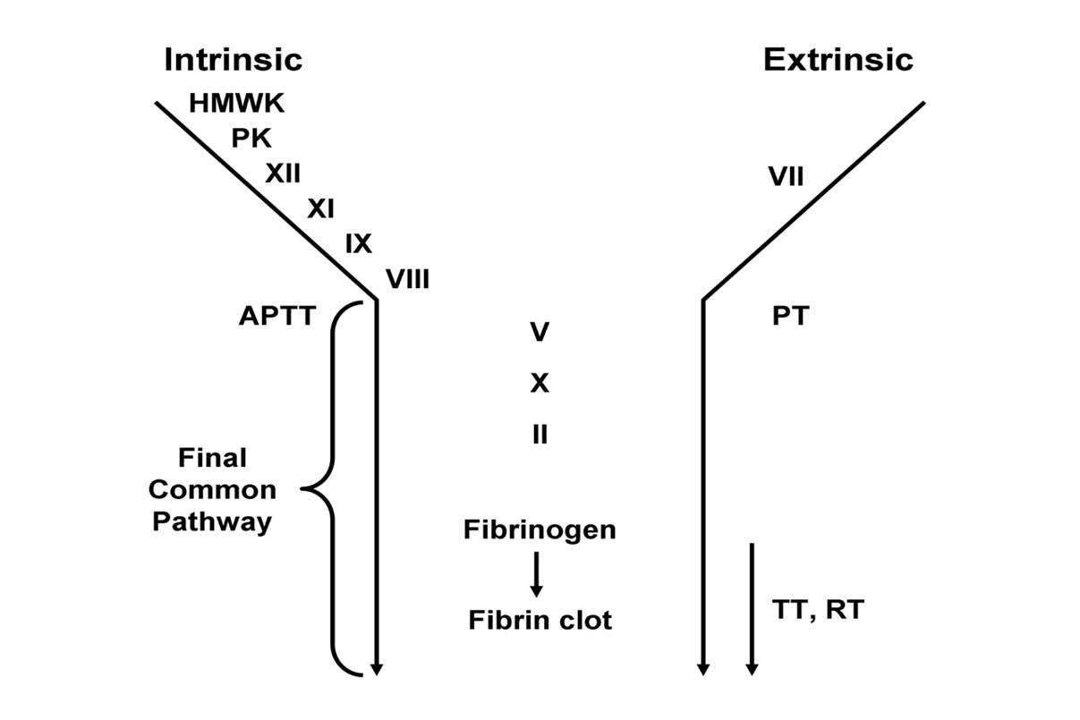
Coagulation Cascade

Slide 6
Coagulation Cascade

Slide 7
Coagulation Cascade

Slide 8
Coagulation Cascade

Slide 9
Outline
Background - Short primer on coagulation pathway and the coagulation tests that are used clinically
Project
Goals – Use clinical laboratory data to substantiate clinical assumptions about the patterns in these tests
Data used – Origin and biases in the data
Results
Conclusions and future directions

Slide 10
Goal 1: Demonstrate that abnormalities in PT and PTT are associated with factors known biologically to be important in these pathways

Slide 11
Goal 2: Relationship: PT/PTT and factor levels
PT/
PTT (sec)
30
16
10
10
15
~40
100
Bleeding
Factor (% of normal)

Slide 12
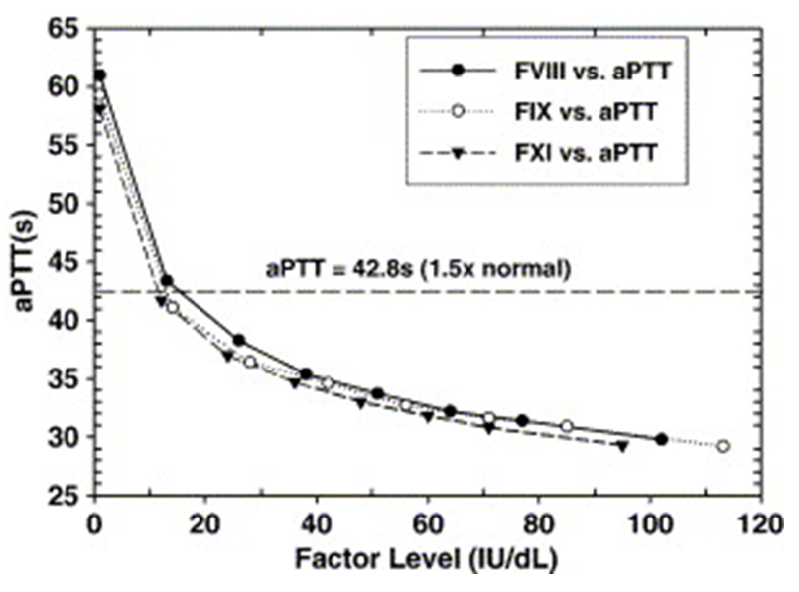

Slide 13
Goal 3: Predict PTT and PT on the basis of factor assays
F8
F12
F2
F10
F11
F9
Fibr
F5
F7
PTT
PT

Slide 14
Data used
Database: ‘Phantom Chemist’
Maintained by Department of Pathology and Lab Medicine for clinical, quality, and research use
Contains clinical lab results data for years (>10)
No patient metadata
Subject to ordering and testing practices at PENN
Few normal results in the dataset
Testing performed in step-wise manner
Over 1x10^6 tests exported over ~1 years
Vast majority did not have predictor and outcome variables

Slide 15
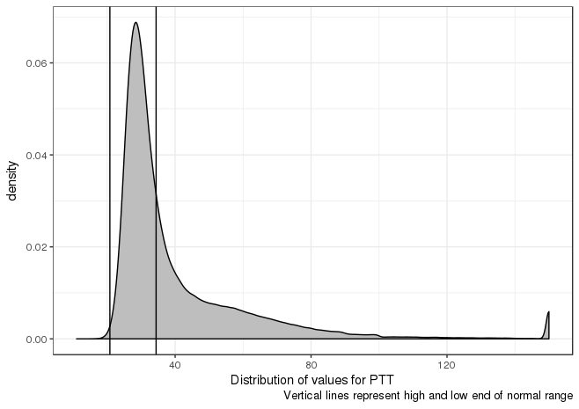
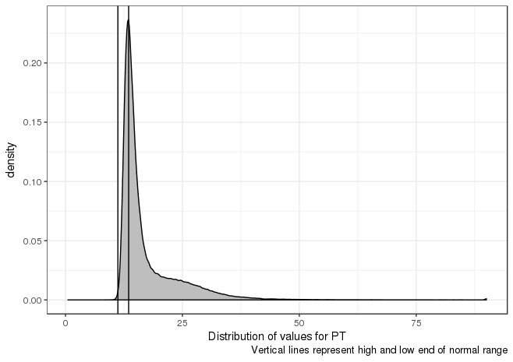
Distribution of Screening test results
PTT
PT

Slide 16
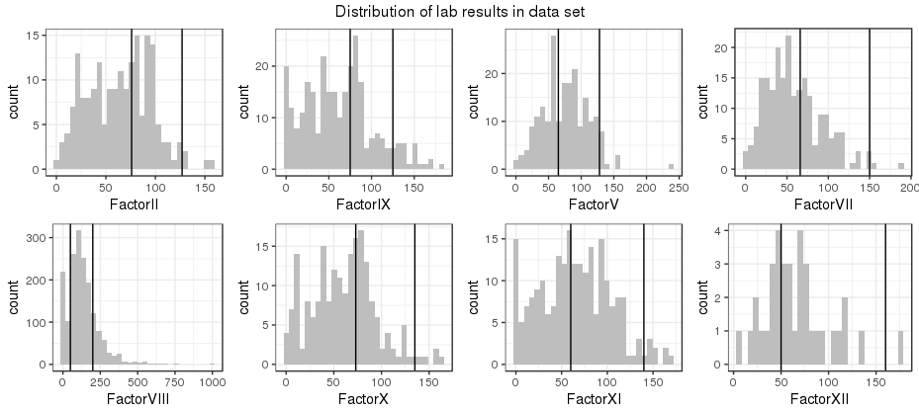
Distribution of individual factor results

Slide 17
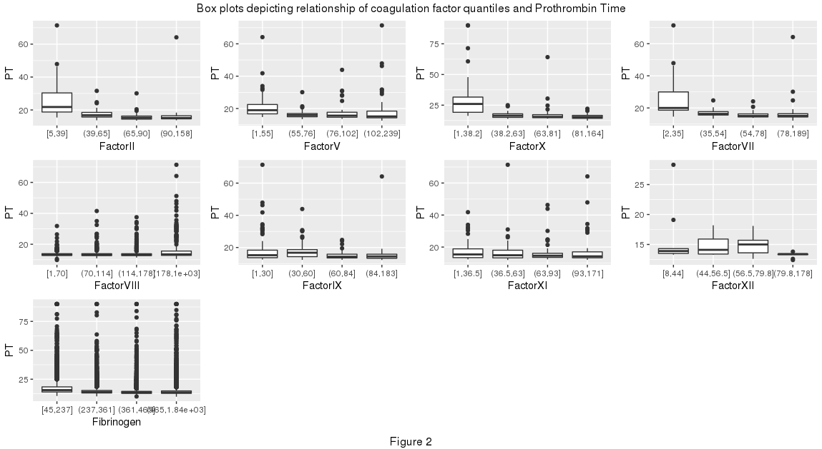
Association of factor quantiles with PT

Slide 18
Association of factor quantiles with PT

Slide 19
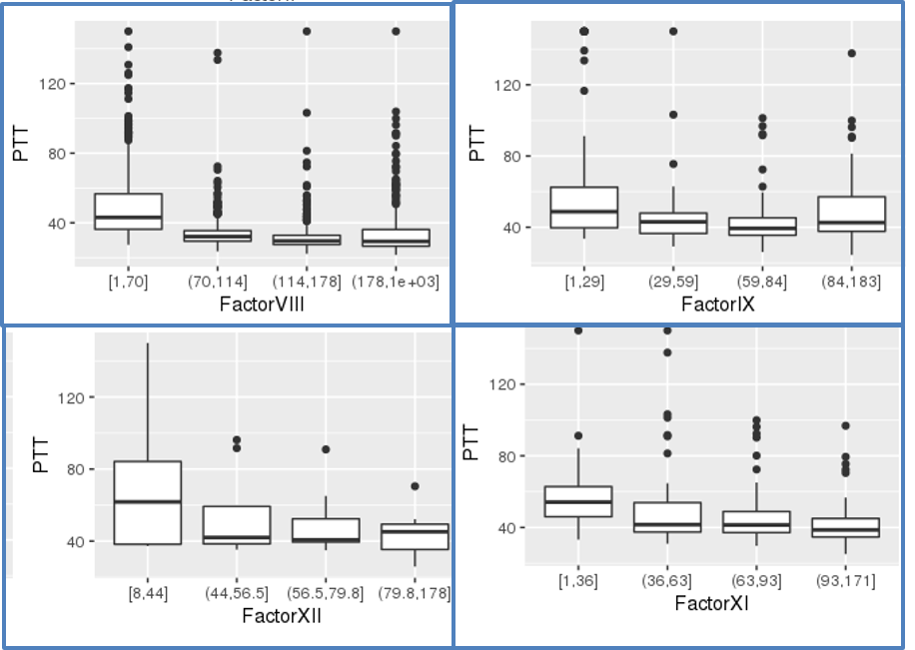
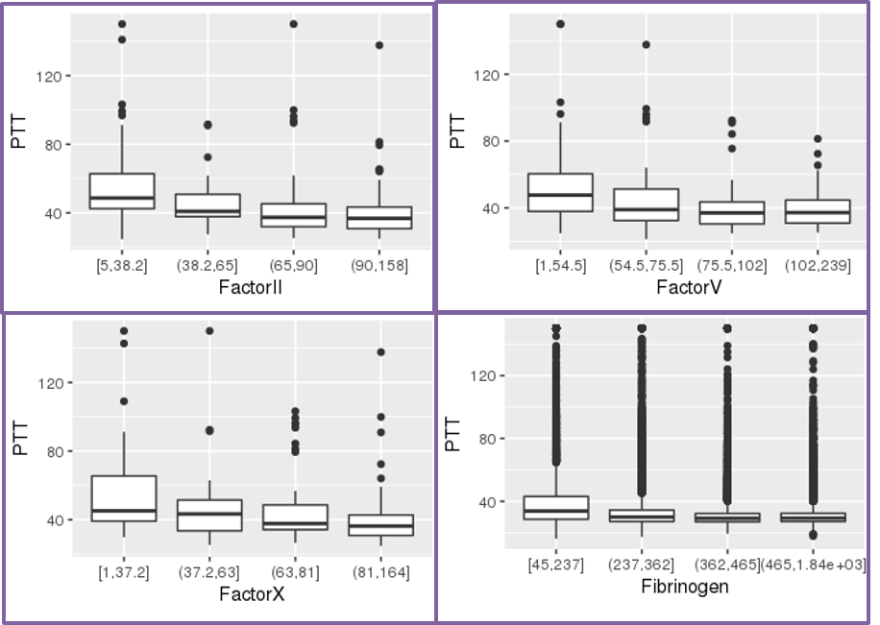
Association of factor quantiles with PTT

Slide 20
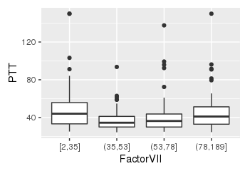
Association of factor quantiles with PTT

Slide 21
Association of factor quantiles with PTT

Slide 22
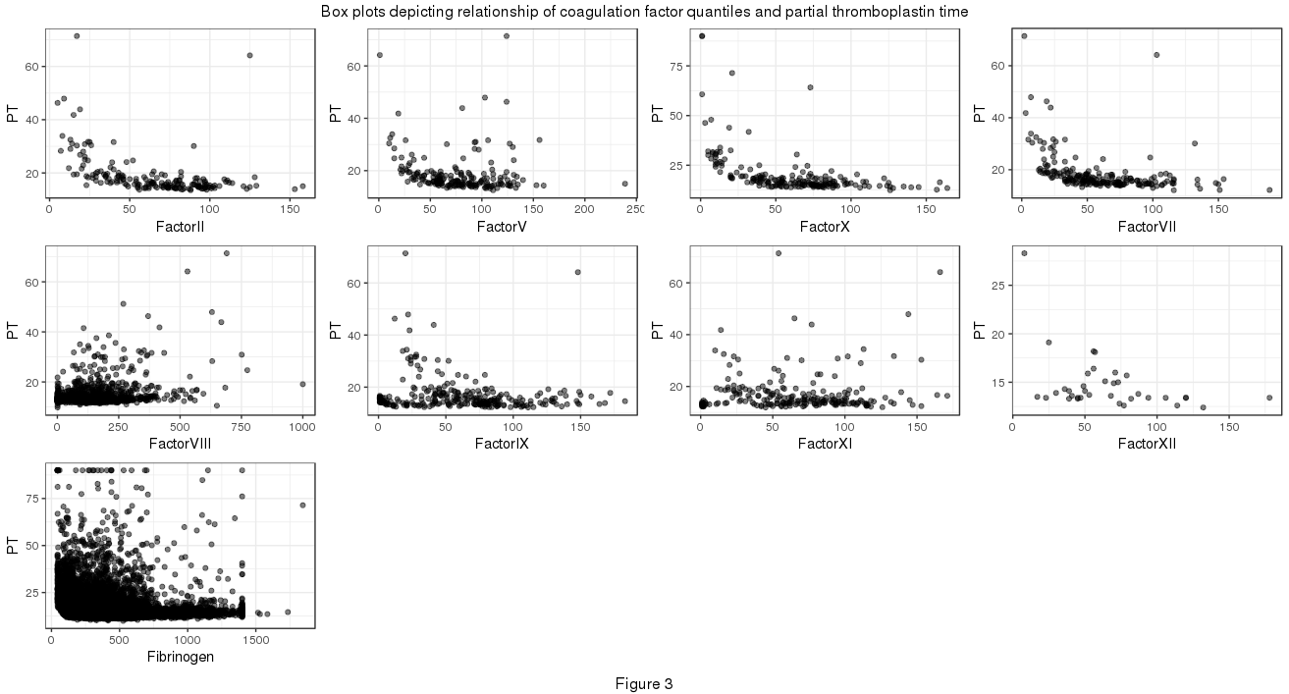
Correlation of factors results with PT

Slide 23
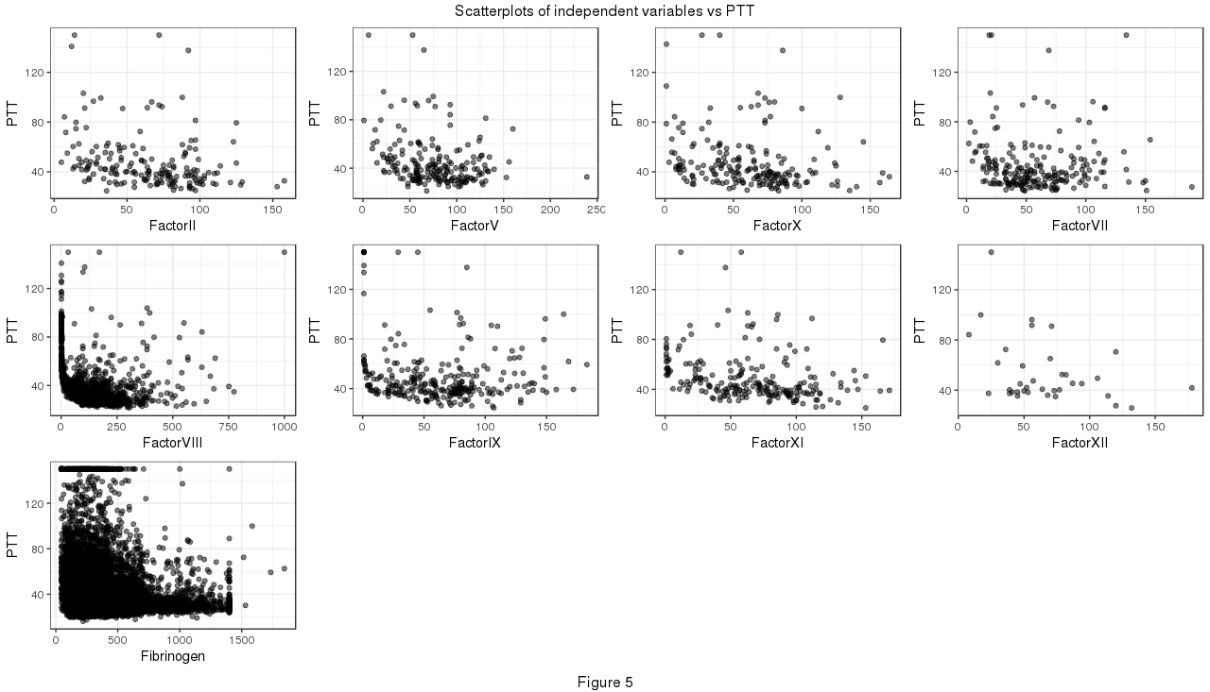
Correlation of factors results with PTT

Slide 24
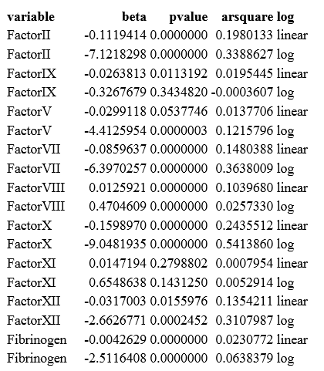
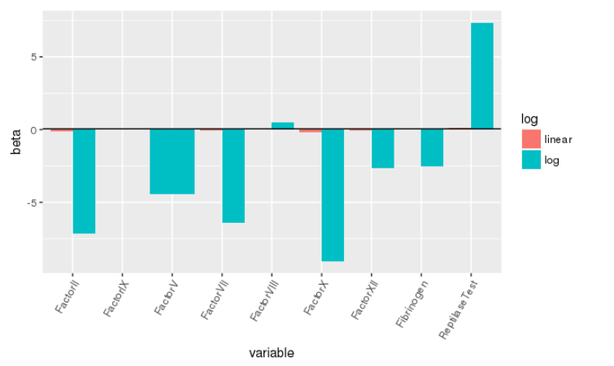
Comparison of linear models of PT vs log transformed and native factor levels

Slide 25
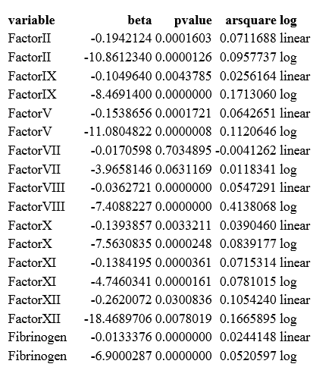
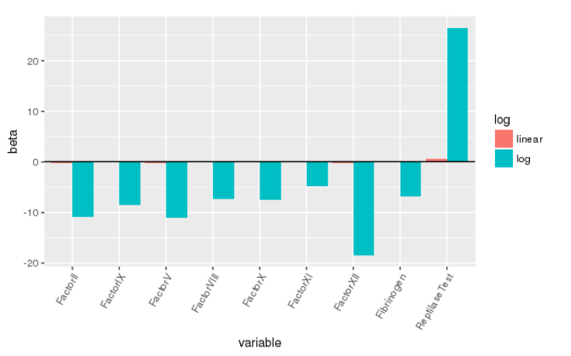
Comparison of linear models of PTT vs log transformed and native factor levels

Slide 26
Regression for prediction of PT and PTT results
LM and RandomForest for regression
5 fold cross-validation
Only ~150 and 100 cases without NA’s ☹

Slide 27
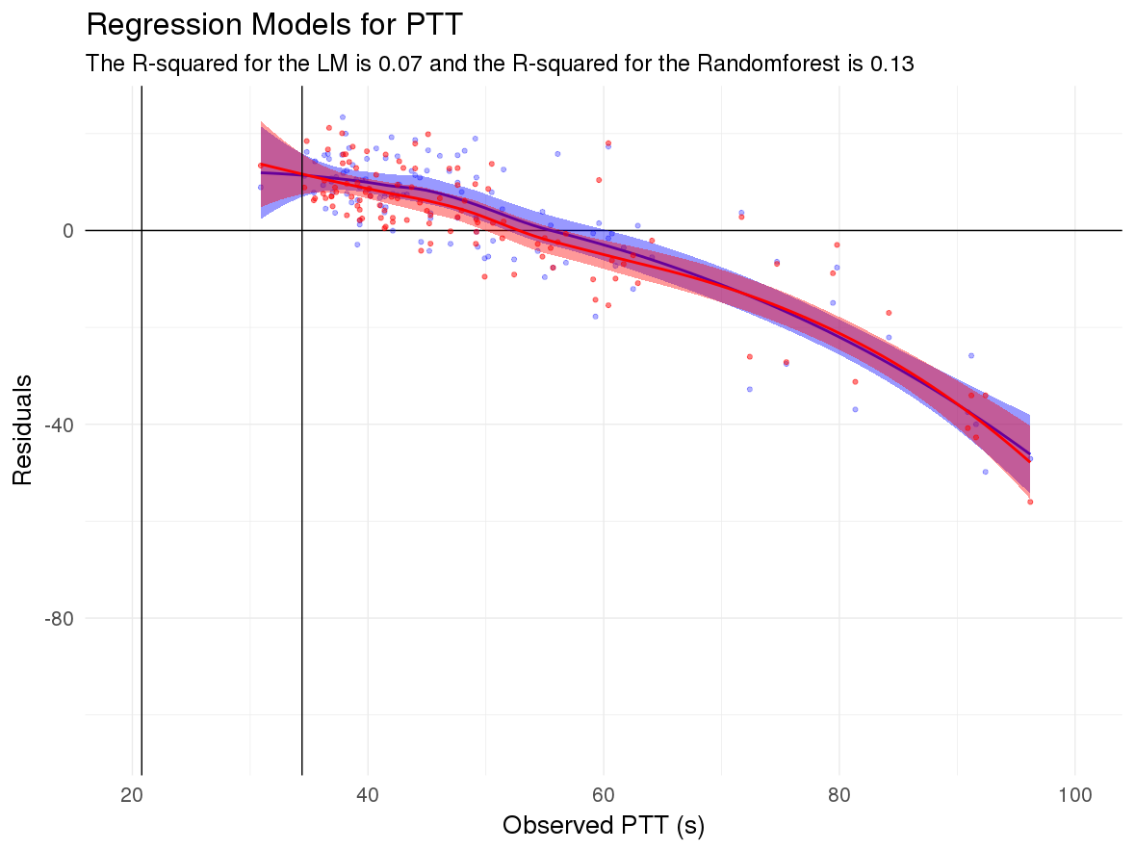
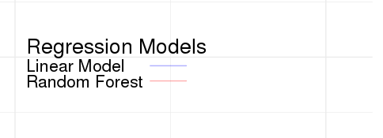

Slide 28
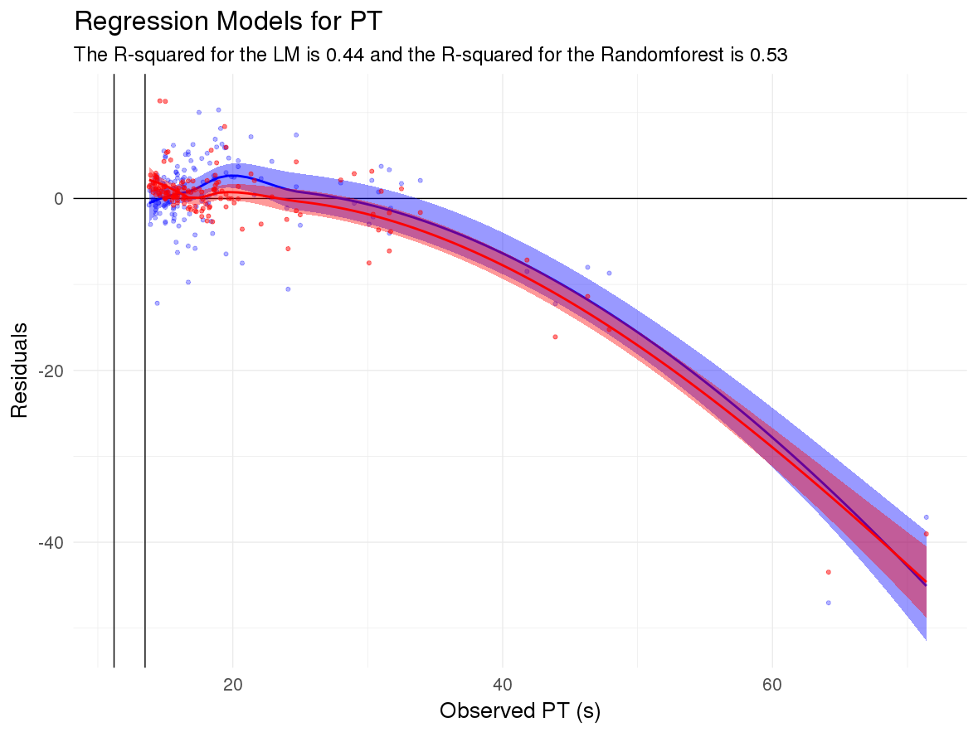

Slide 29
Conclusions
Clinical lab data supports the association of specific coagulation factors with the screening assays they are meant to screen for
Relationship between these is approximately logarithmic as suggested in literature
Further work will be performed to increase accuracy of the models for prediction, perhaps including additional data

Slide 30
Coagulation Cascade

